Slide 1
CGI simulated scenes
Maxime Rizzo, Neil Zimmerman, Aki Roberge (NASA GSFC)
Ewan Douglas (MIT/Cahoy Lab)
Laurent Pueyo (STScI)

Slide 2
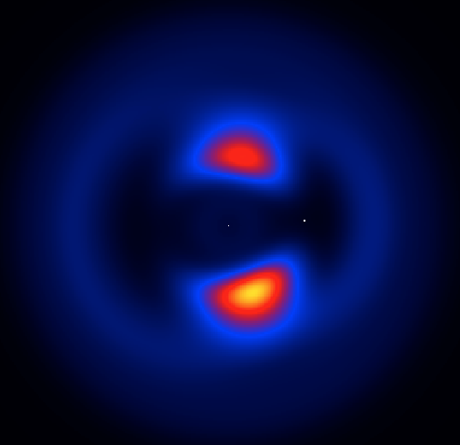
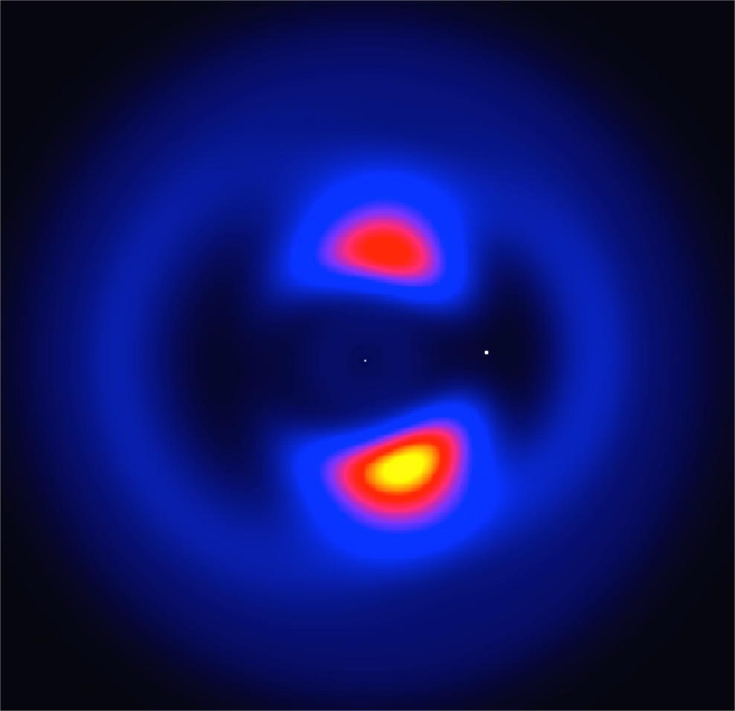
CGI simulated scenes: “Haystacks”
Sun-like star at 3pc
Jupiter-size companion at 2AU
Dust distribution from C. Stark, 10 zodis
One slice for each filter

Slide 3
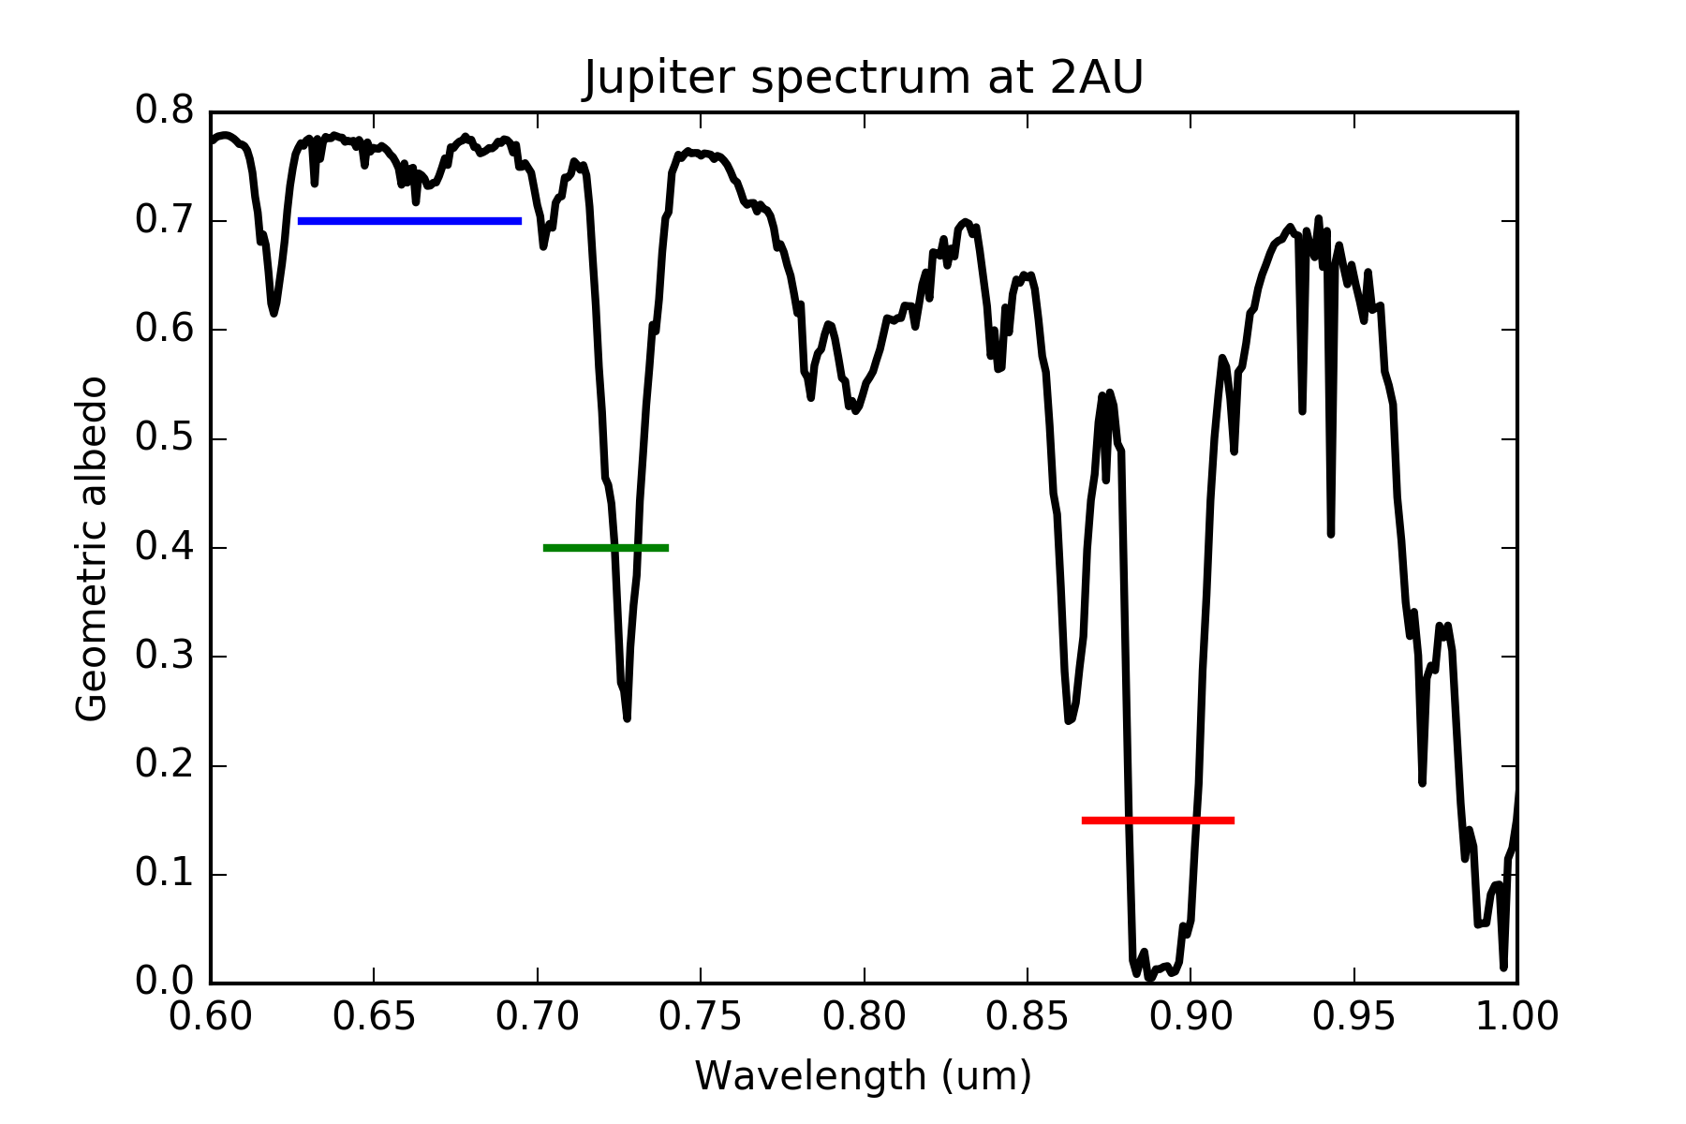
WFIRST bands
F661
F721
F883
Spectrum from Cahoy+ 2010

Slide 4

CGI WFE simulations

Slide 5
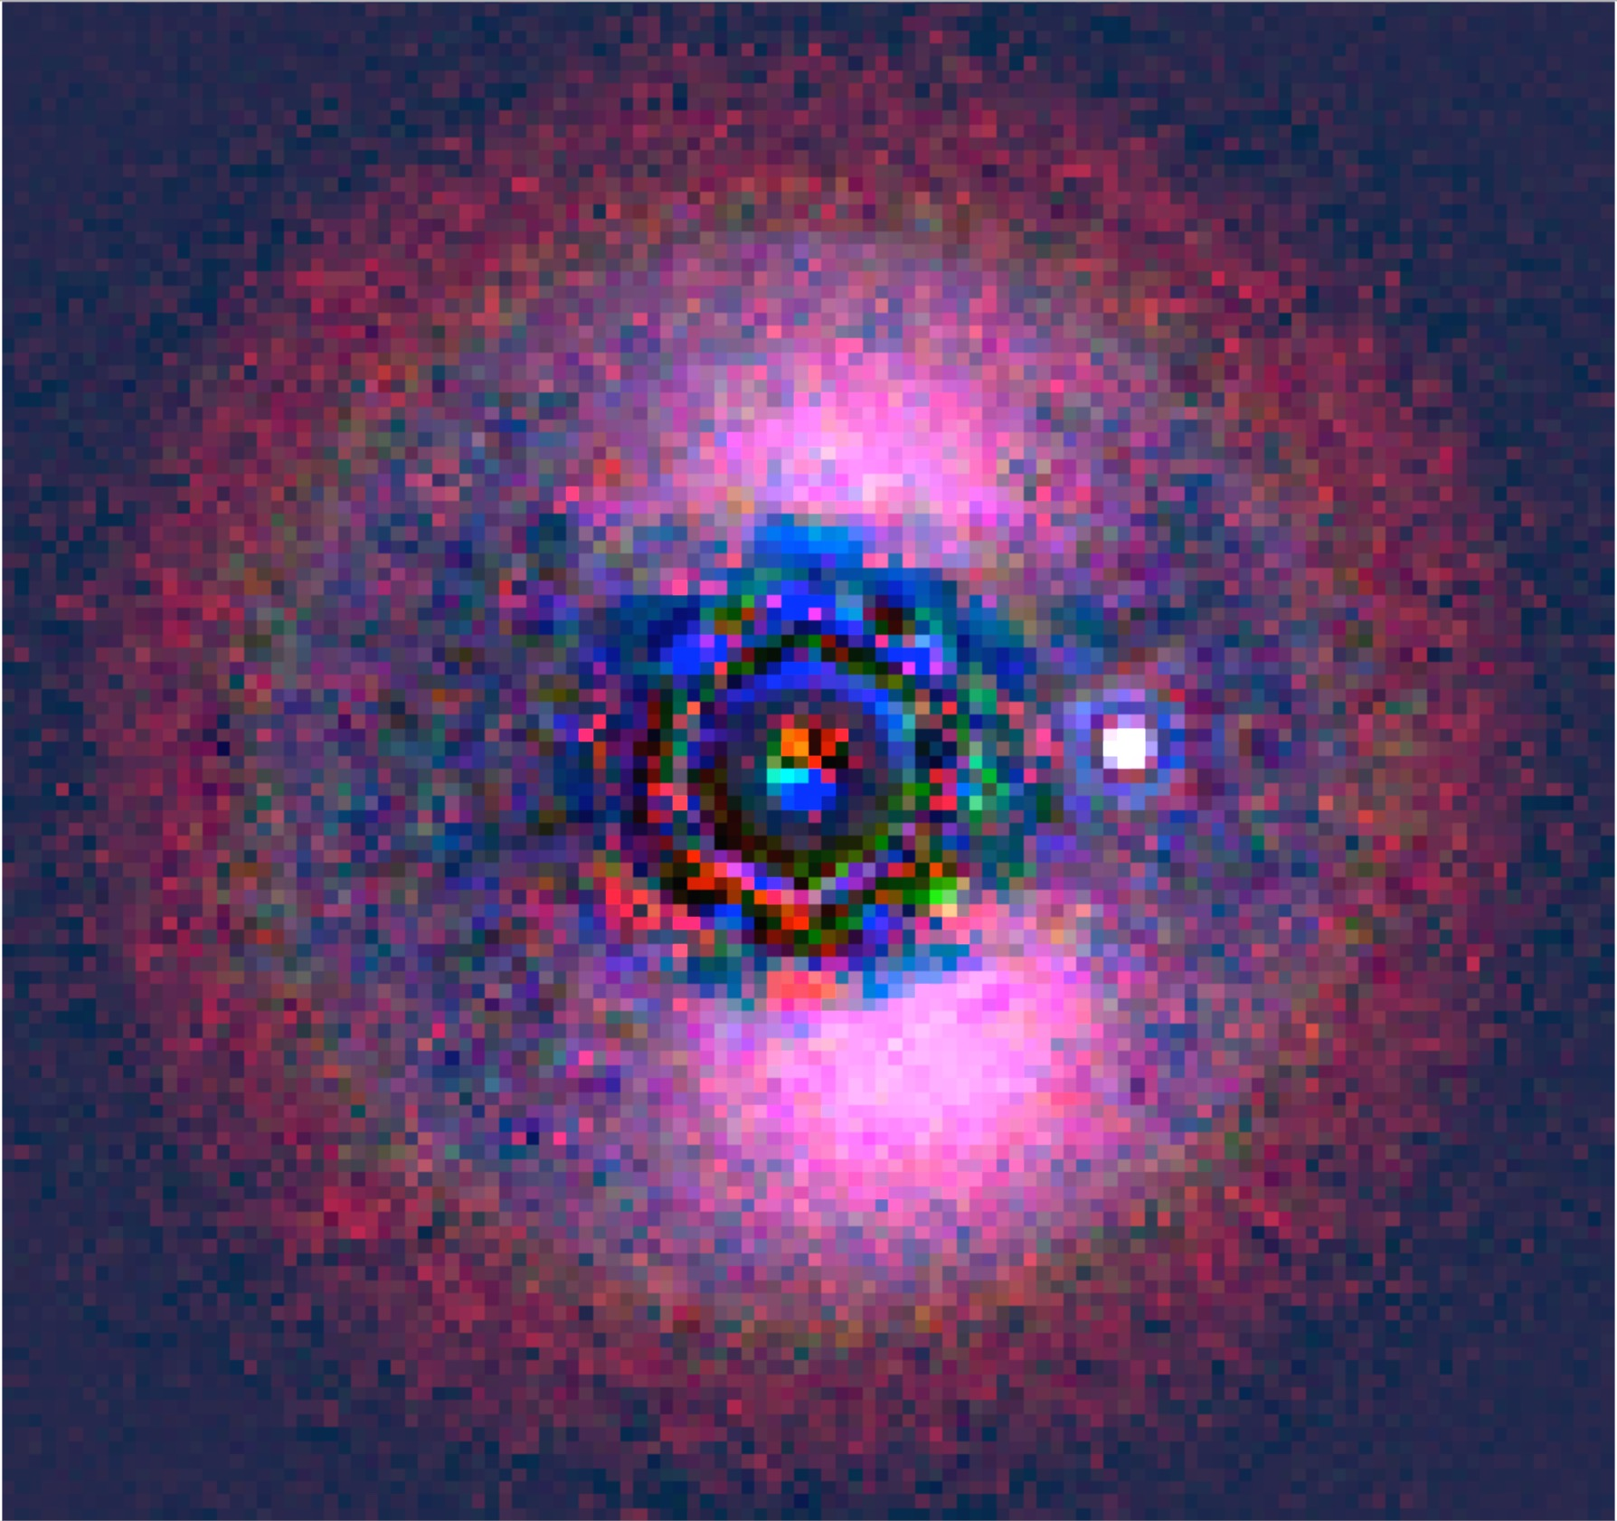
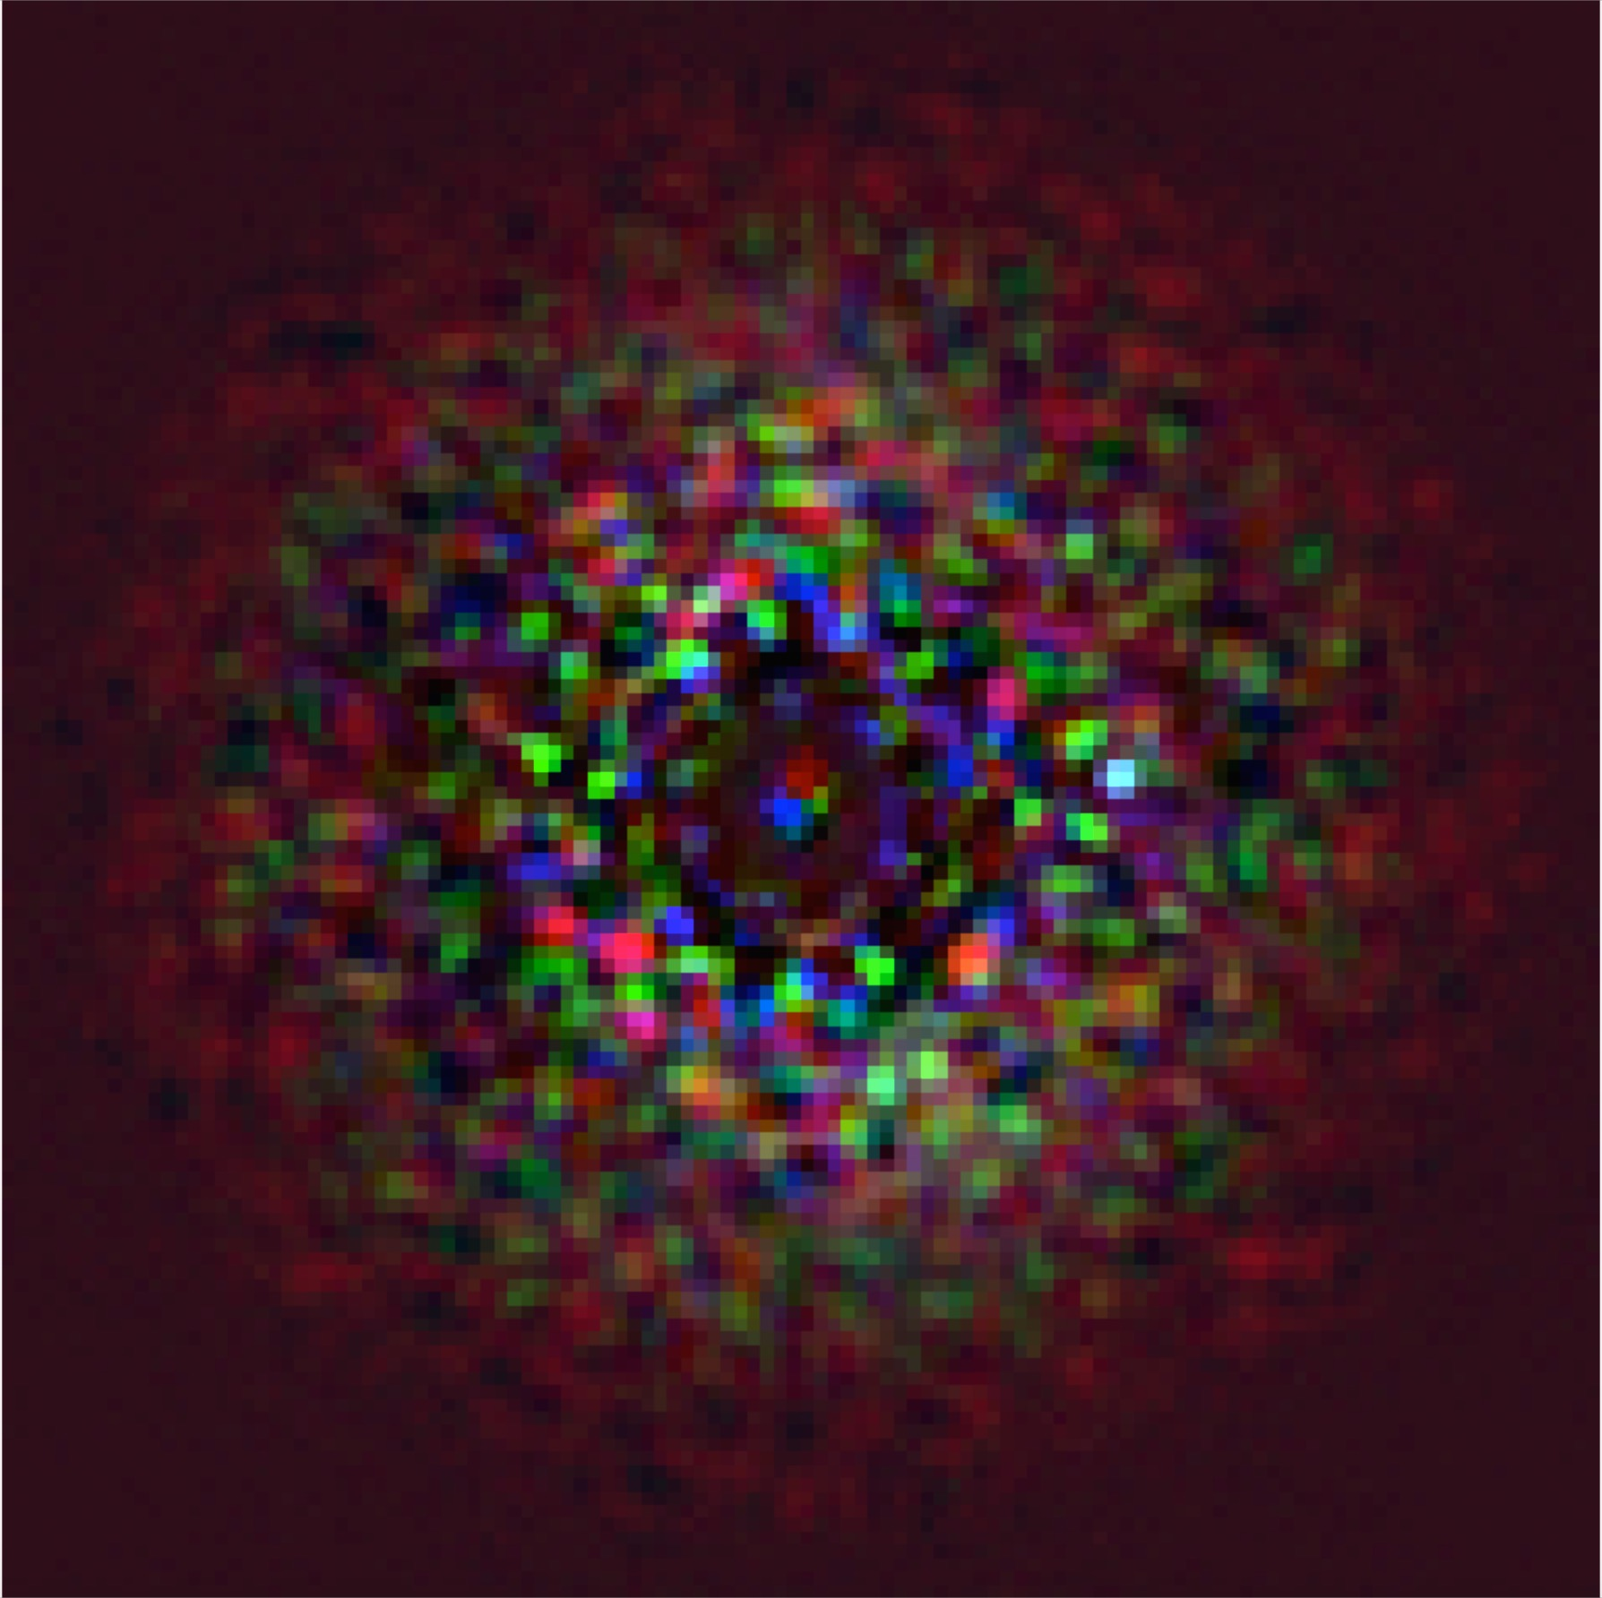
Varying high-order WFE
10pm
100pm

Slide 6
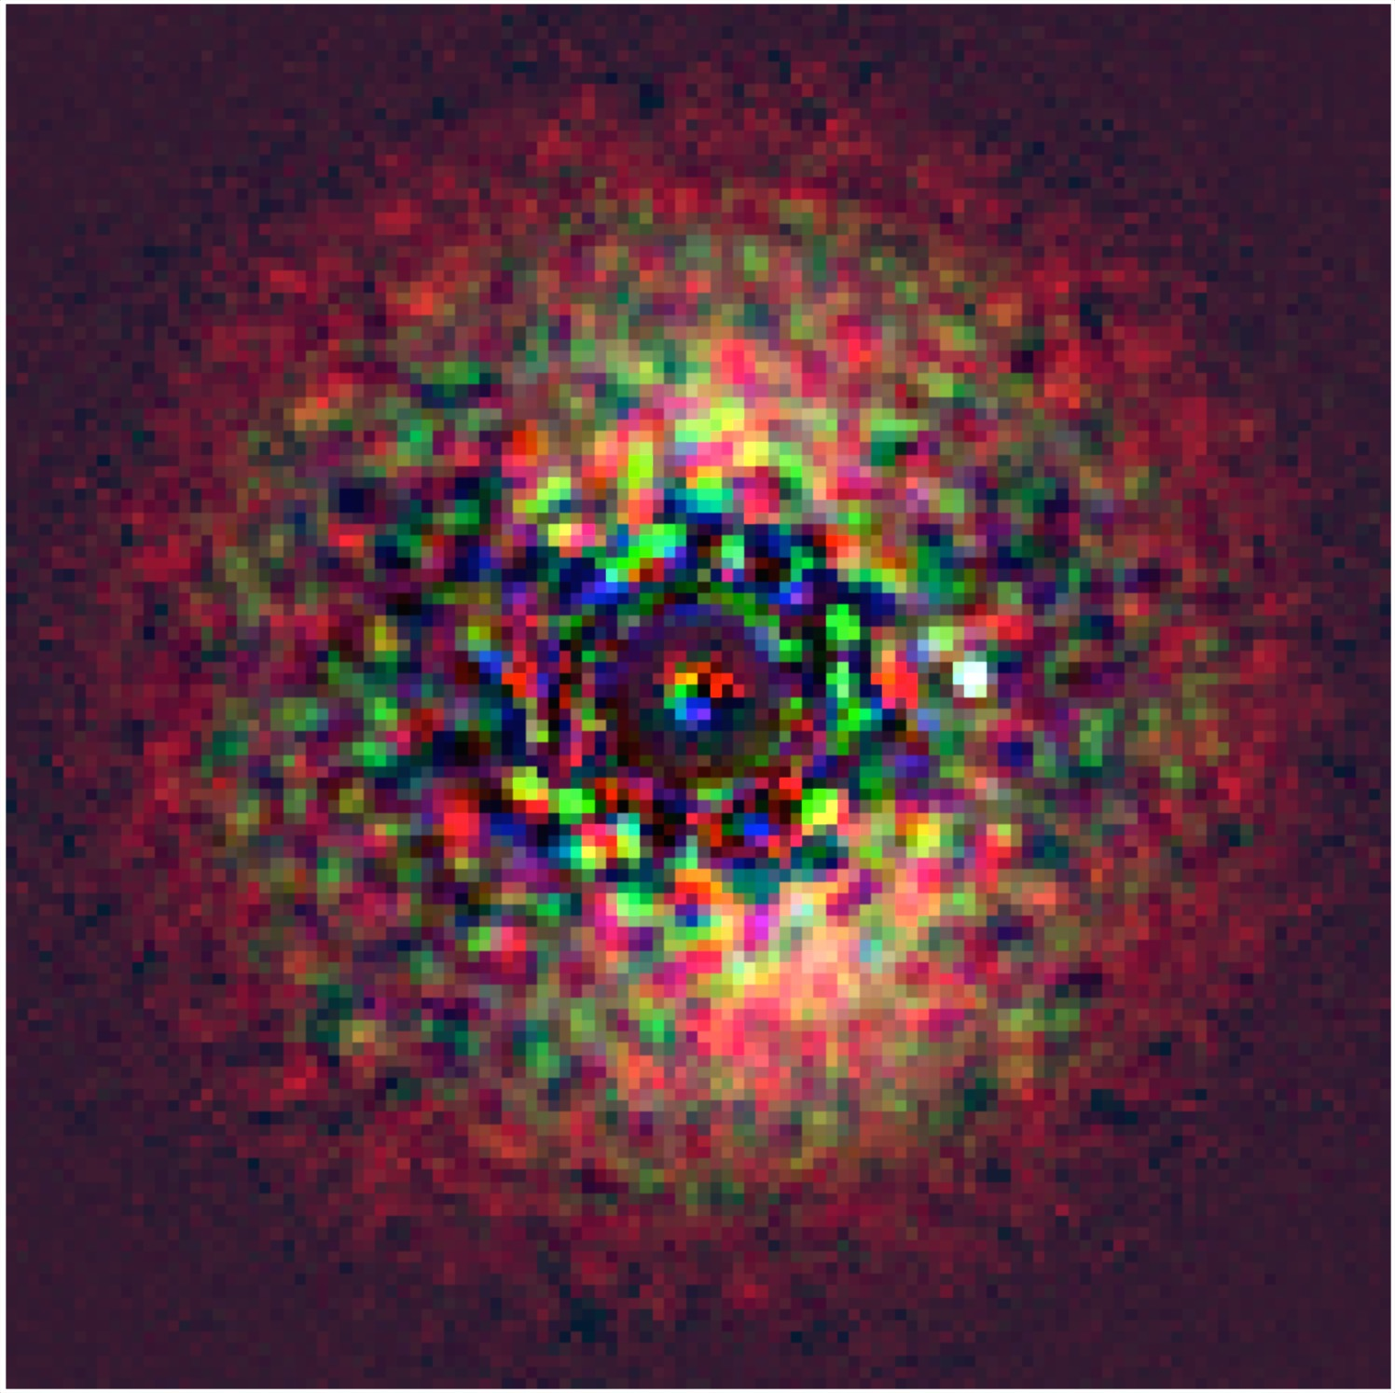
Next steps
Model all WFIRST bands
Unit testing
EM+Traps detector model
Incorporate with IFS simulator
Staged sharing with the community
Soon: source code and example notebooks
Later: web-based tool where users can update a model scene and get back a simulated image (similar to WFI tool STIPS*)?
*http://www.stsci.edu/wfirst/software/STIPS

Slide 7
Backup slides

Slide 8
Coronagraph model
Shaped pupil “disk mode”
6->20 lambda/D
Using webbpsf/POPPY
Created a look-up table of off-axis PSFs for every sampling element for each filter (~10GB total)
Used lambda/4D @ 661nm as spatial sampling element
For any input field, bin to correct spatial sampling and multiply each pixel by corresponding off-axis PSF

Slide 9
OPD errors
Generated 100 realizations of OPD wavefront error
Both low-order and high order
High-order WFE are scalable
Averaged the first 50 realizations to generate a ‘library PSF’
Averaged the last 50 to generate the ‘observed’ star, add to the scene

Slide 10
Detector sampling and noise
Assume the detector pixel is lambda/2D @ 661nm
Assume an efficiency factor at the CGI entrance from J. Krist
webbpsf simulates CGI efficiency
Observed 6, 3 and 3 hours in F661, F721, F883
Divide exposure time into 100 s exposures
Assume only Poisson noise on the observed scene, no noise on the ‘library PSF’
Assume QE, dark current, CIC, read noise from Harding et al. 2016 paper
No photon counting mode, EM-noise, or traps

Slide 11
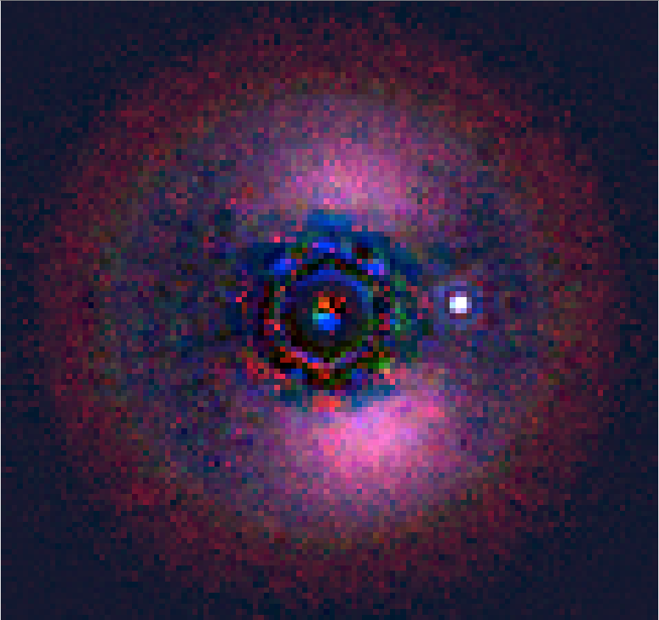
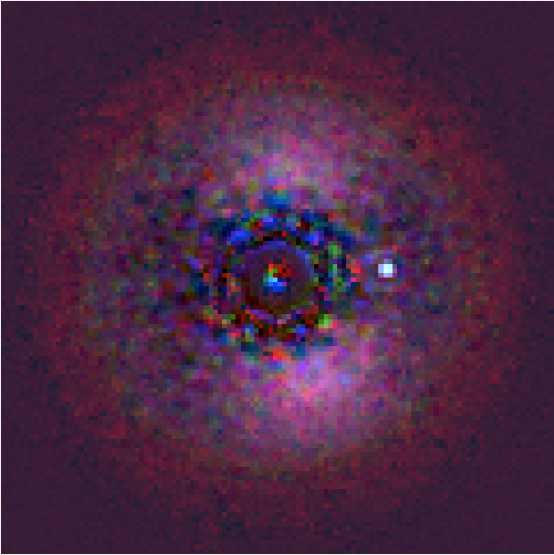
Varying high-order WFE
10pm
25pm

